Slide 1
Be careful that
In new analysis (choicedynamicsharedwithtoan), meaning of colors is different:
-When switches is based on Actor A
Red: at switch timing
Dark blue: timing all trials
Light turquoise: at switch timing
-When Switches is based on actor B:
Dark blue: at switch timing
Red: timing all trials
Pink: at switch timing

Slide 2
Be careful that…
Calculating the average choice before and after RB, BR transitions have to follow a rule:
For BR switches, lets say switch happens at every 6th trials, so in 5 previous trials, ‘’at least’’ have to be 3 B( not necessarily consecutive) , and in the next 5 trials after trianstion ‘’at least’’ have to be 3 R ( not necessarily consecutive), then if this happens, that BR transition is a valid transition, otherwise we shouldn’t take that transition into account.
So define two variables:
LenghtBeforeAfterSwitch = 5
MinimumSameColor = 3

Slide 3
Be careful that
Error bars have to be SEM across transitions
Sebastian said: new_dyadicEphys_HP-NHP_data contains both predictable and non predictable human, only do single session analysis on them and don’t do session concatenation

Slide 4
We decided to get average among monkeys to merge 12 plots to only 6 plots, this is an example of what we get average from (next slide)

Slide 5
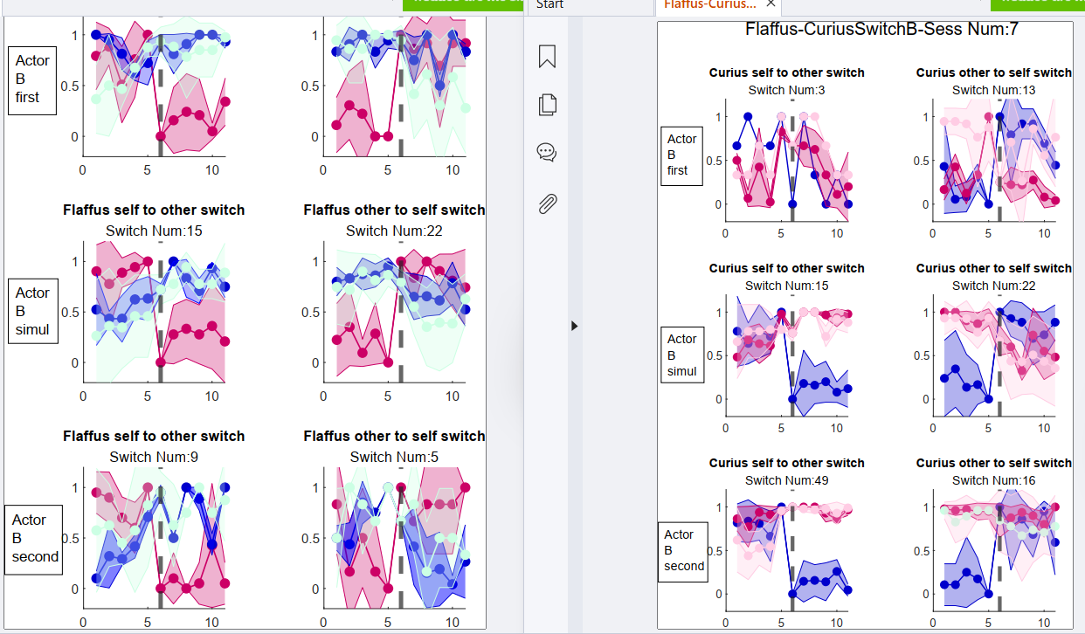
Average among red curve and blue curve, red curve is when Flaffus was second and he switched from self to other (at switch timing) and blue curve is when Curius was second and he switched from self to other (timing at switch)

